Slide 1
Prediction of leaf diseases using Convolutional Neural Networks.
Mentor : Dr Poomagal S
Team Members:
Alagu V RA
Bharathi B
Nandhikashri A

Slide 2
Objective:
Creating a mobile application which will detect whether the leaf is healthy or not

Slide 3
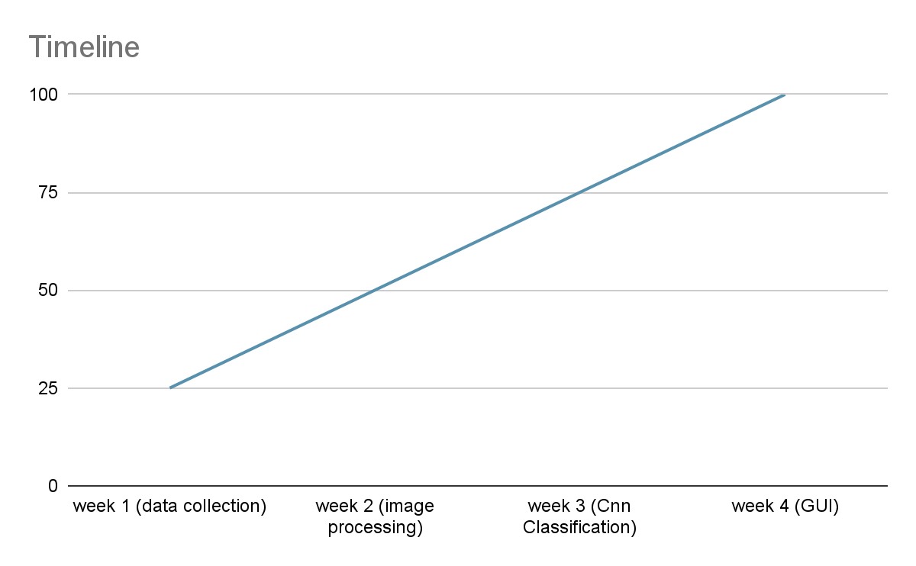
Timeline
Data Collection
Image Processing
CNN Classification
GUI Creation

Slide 4
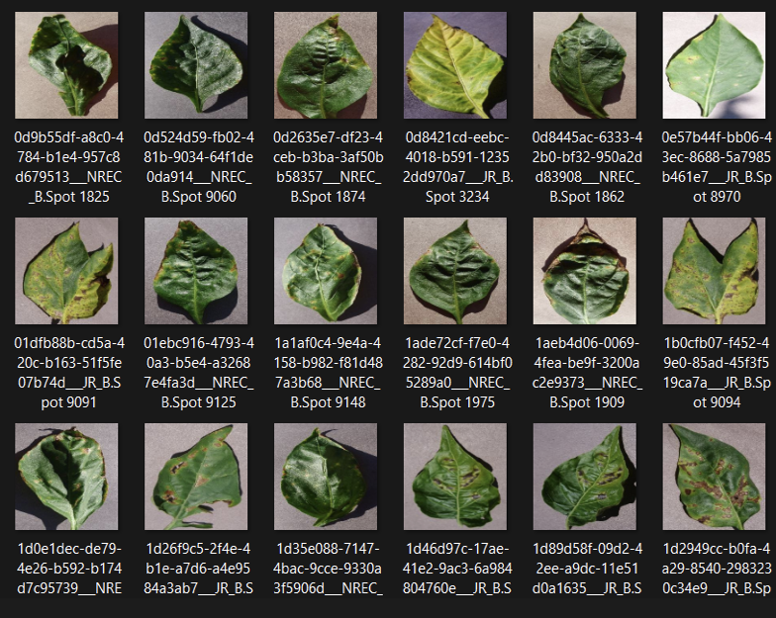
Example of the dataset

Slide 5
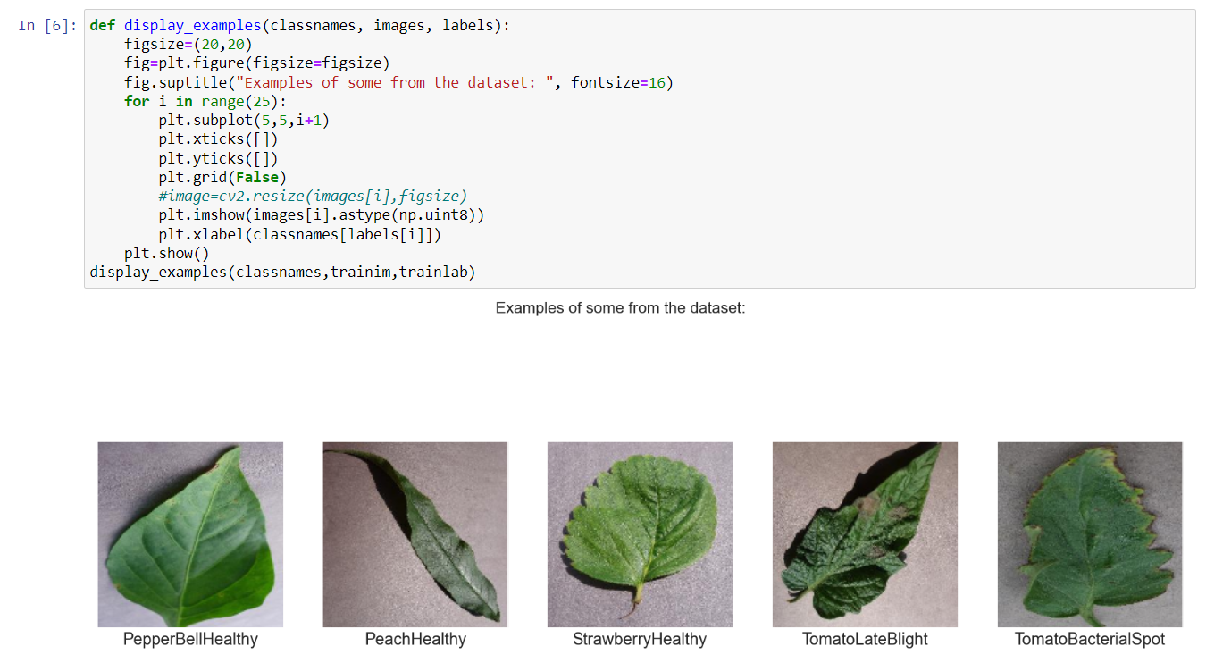
Example of image processing :

Slide 6
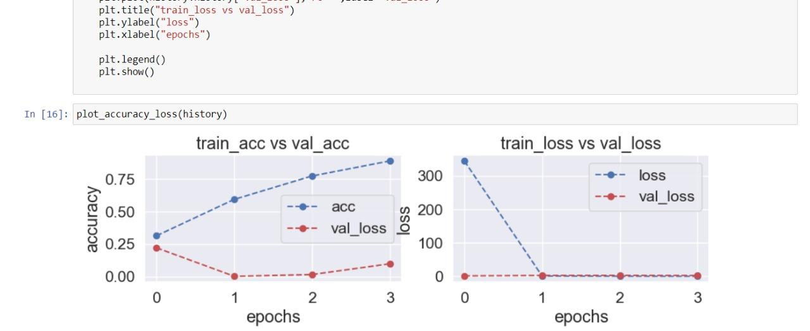

Slide 7
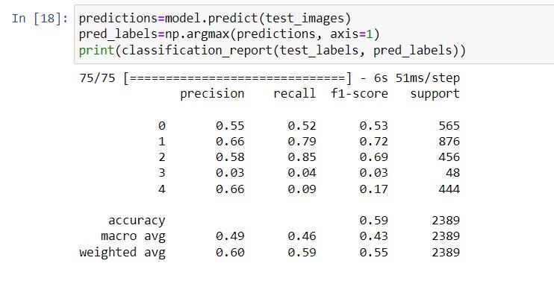

Slide 8
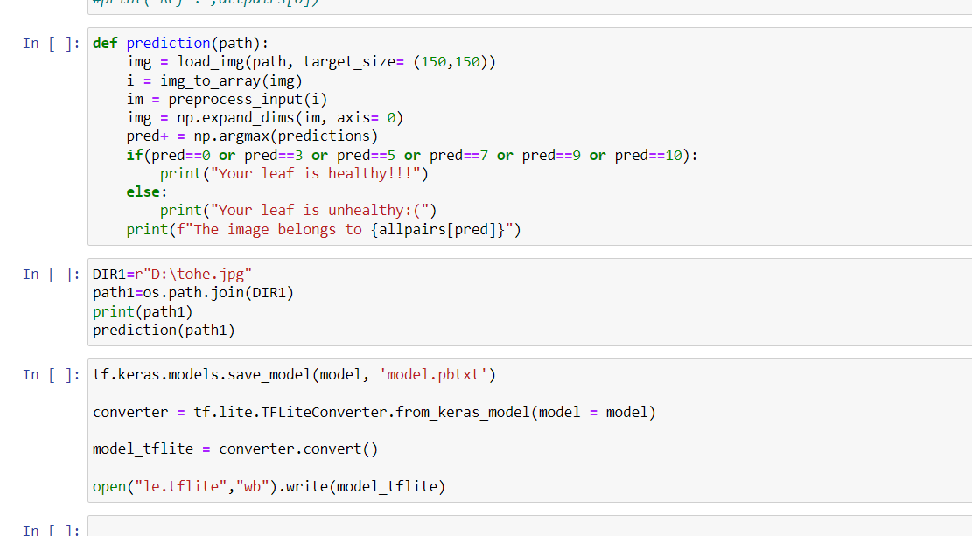
Predicting leaf health

Slide 9
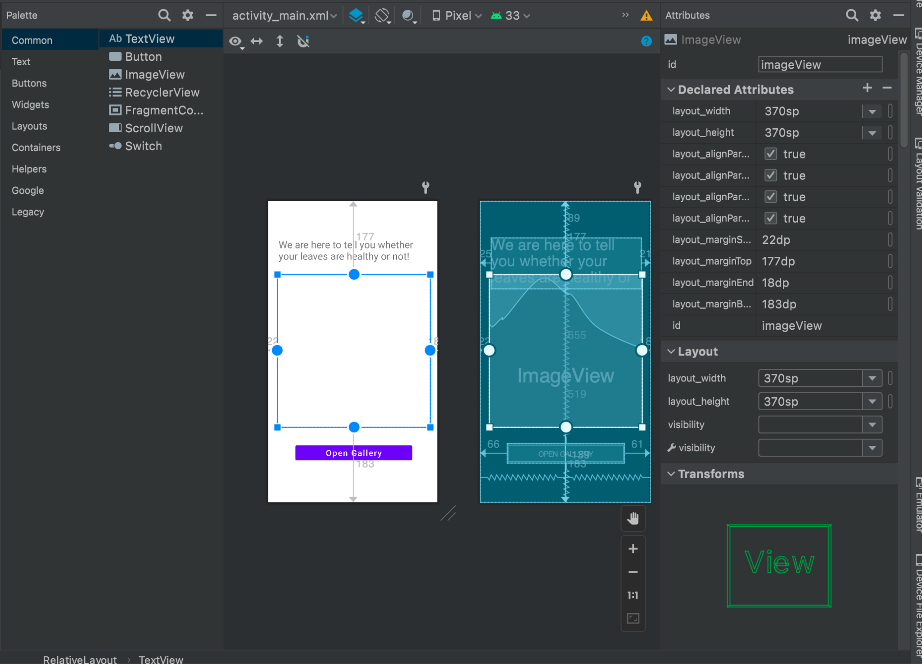
GUI Creation

Slide 10
THANK YOU

